Slide 1

IMDB score prediction for movies

Slide 3
Content
Data:-
Poster_Link - Link of the poster that imdb using
Series_Title = Name of the movie
Released_Year - Year at which that movie released
Certificate - Certificate earned by that movie
Runtime - Total runtime of the movie
Genre - Genre of the movie
IMDB_Rating - Rating of the movie at IMDB site
Overview - mini story/ summary
Meta_score - Score earned by the movie
Director - Name of the Director
Star1,Star2,Star3,Star4 - Name of the Stars
No_of_votes - Total number of votes
Gross - Money earned by that movie

Slide 4
Inspiration
Analysis of the gross of a movie vs directors.
Analysis of the gross of a movie vs different - different stars.
Analysis of the No_of_votes of a movie vs directors.
Analysis of the No_of_votes of a movie vs different - different stars.
Which actor prefer which Genre more?
Which combination of actors are getting good IMDB_Rating maximum time?
Which combination of actors are getting good gross?

Slide 5
movie_data <- read_csv("/kaggle/input/imdb-dataset-of-top-1000-movies-and-tv-shows/imdb_top_1000.csv")
Rows: 1000 Columns: 16 ── Column specification ──────────────────────────────────────────────────────── Delimiter: "," chr (12): Poster_Link, Series_Title, Released_Year, Certificate, Runtime, Ge... dbl (3): IMDB_Rating, Meta_score, No_of_Votes num (1): Gross ℹ Use `spec()` to retrieve the full column specification for this data. ℹ Specify the column types or set `show_col_types = FALSE` to quiet this message.

Slide 6
#Making a copy of the data Analysis <- movie_data
dim(Analysis)

Slide 7
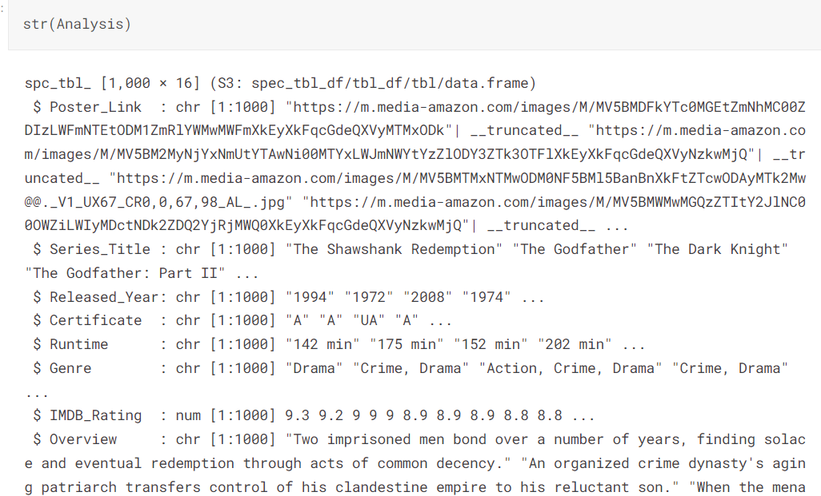

Slide 8
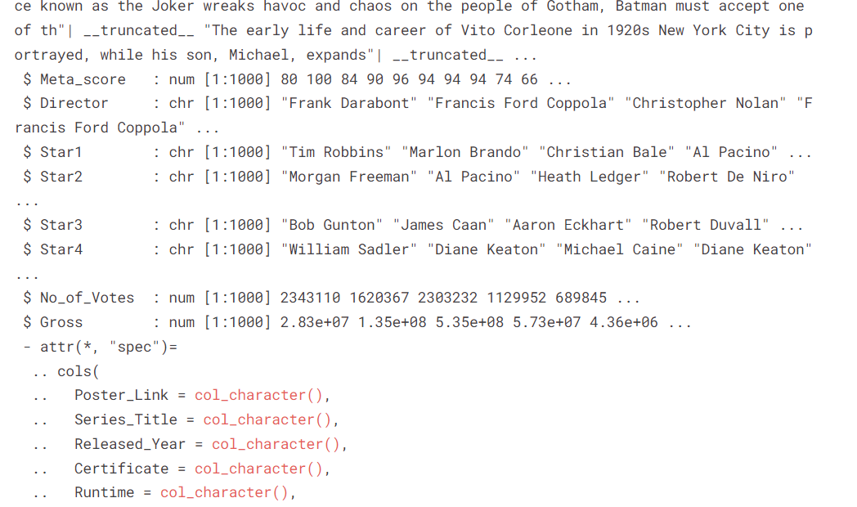

Slide 9
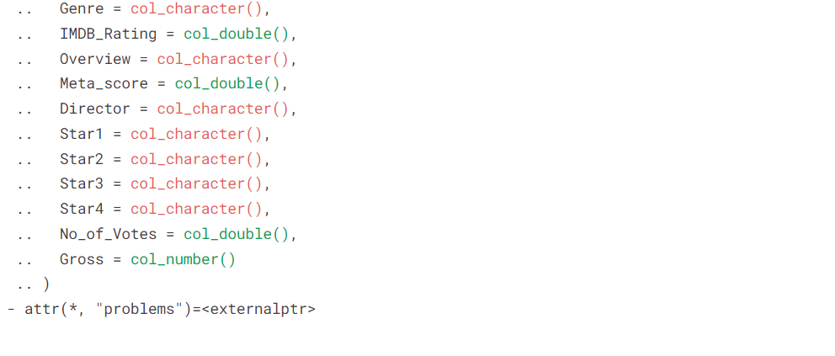

Slide 10
Rows: 1,000 Columns: 16 $ Poster_Link <chr> "https://m.media-amazon.com/images/M/MV5BMDFkYTc0MGEtZmN… $ Series_Title <chr> "The Shawshank Redemption", "The Godfather", "The Dark K… $ Released_Year <chr> "1994", "1972", "2008", "1974", "1957", "2003", "1994", … $ Certificate <chr> "A", "A", "UA", "A", "U", "U", "A", "A", "UA", "A", "U",… $ Runtime <chr> "142 min", "175 min", "152 min", "202 min", "96 min", "2… $ Genre <chr> "Drama", "Crime, Drama", "Action, Crime, Drama", "Crime,… $ IMDB_Rating <dbl> 9.3, 9.2, 9.0, 9.0, 9.0, 8.9, 8.9, 8.9, 8.8, 8.8, 8.8, 8… $ Overview <chr> "Two imprisoned men bond over a number of years, finding… $ Meta_score <dbl> 80, 100, 84, 90, 96, 94, 94, 94, 74, 66, 92, 82, 90, 87,… $ Director <chr> "Frank Darabont", "Francis Ford Coppola", "Christopher N… $ Star1 <chr> "Tim Robbins", "Marlon Brando", "Christian Bale", "Al Pa… $ Star2 <chr> "Morgan Freeman", "Al Pacino", "Heath Ledger", "Robert D… $ Star3 <chr> "Bob Gunton", "James Caan", "Aaron Eckhart", "Robert Duv… $ Star4 <chr> "William Sadler", "Diane Keaton", "Michael Caine", "Dian… $ No_of_Votes <dbl> 2343110, 1620367, 2303232, 1129952, 689845, 1642758, 182… $ Gross <dbl> 28341469, 134966411, 534858444, 57300000, 4360000, 37784…

Slide 11
sapply(Analysis, class)
Poster_Link 'character' Series_Title 'character' Releasedyear 'character' Certificate 'character' Runtime 'character' Genre IMDB_Rating 'numeric' Overview 'character' Meta_score 'numeric' Director character' Star1 'character' Star2 'character' Star3 'character' Star4 character' No_of_Votes 'numeric' Gross numeric'

Slide 12
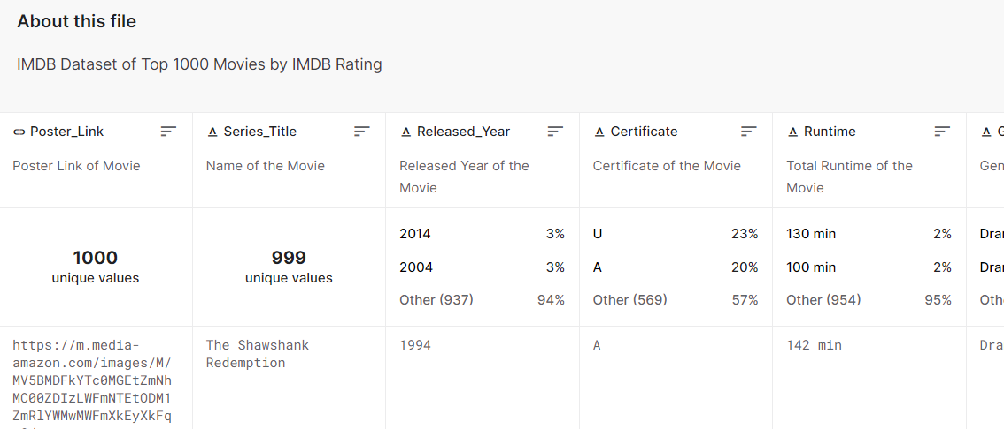

Slide 13
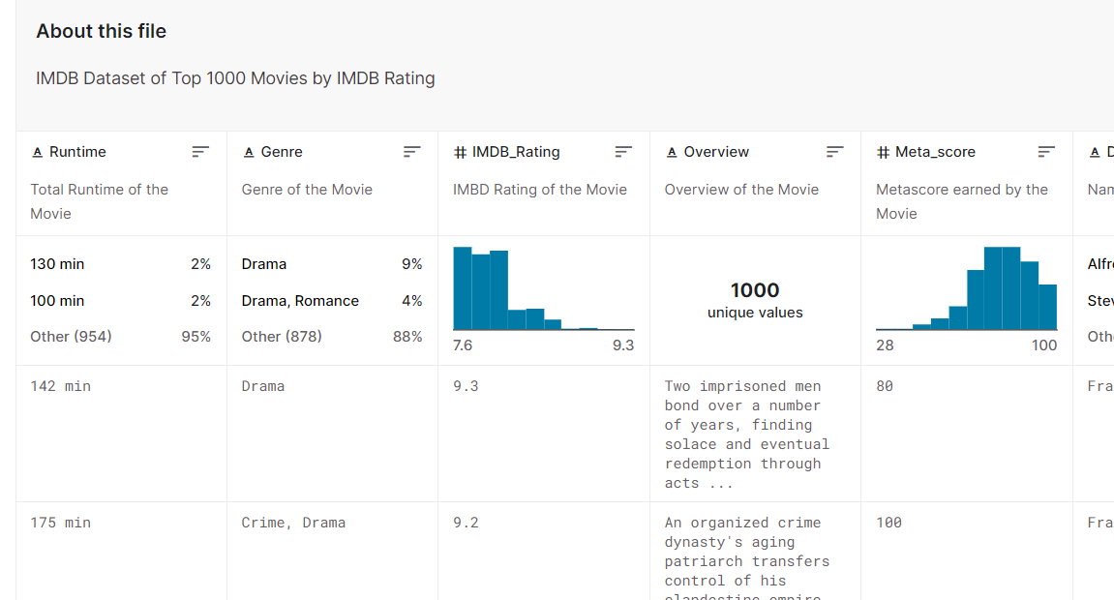

Slide 14
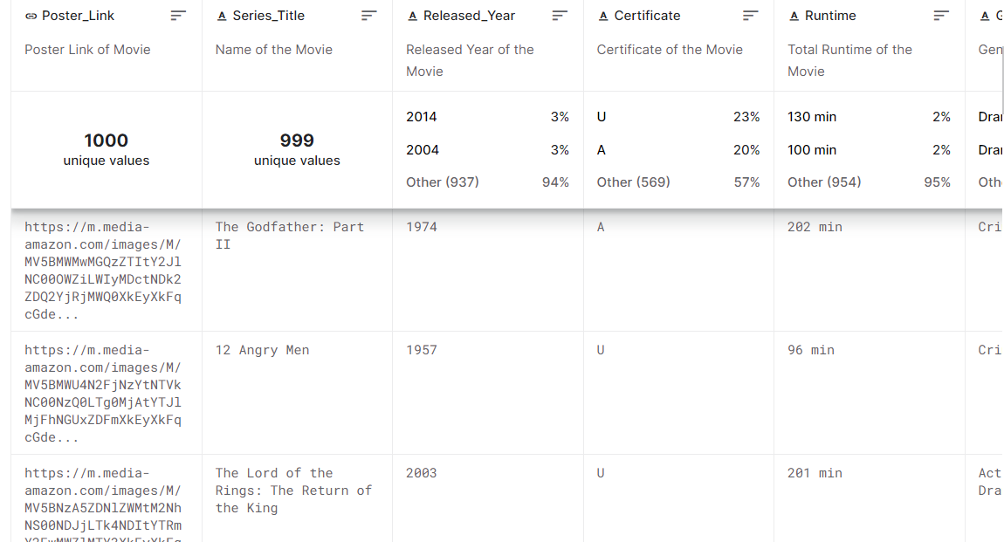

Slide 15
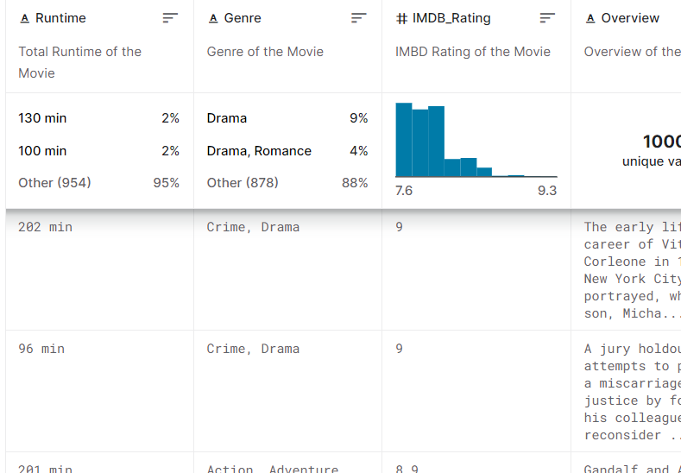

Slide 16
